Slide 1

OBSERVATION
Alex, Ashani, Coffee, Giulia, Tania

Slide 2
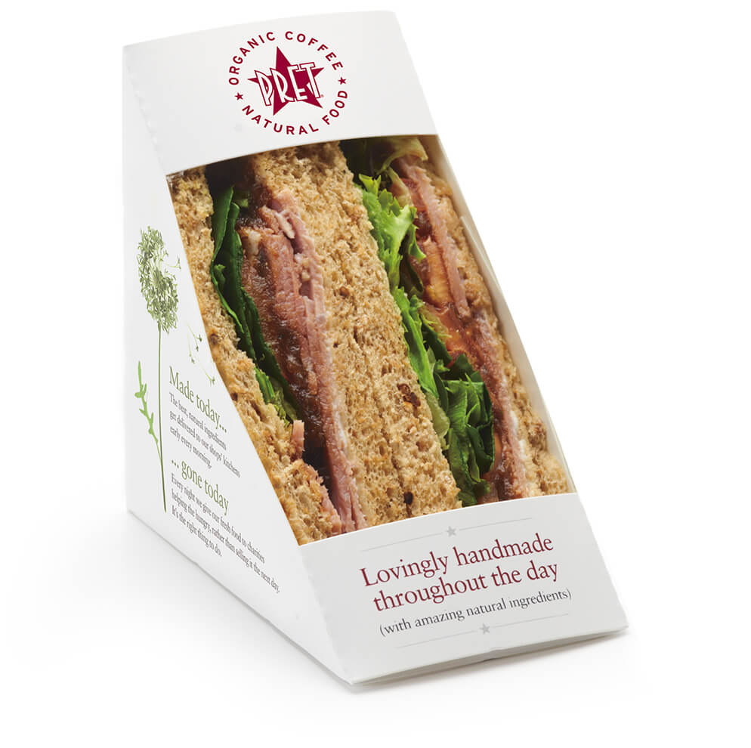
Introduction
International sandwich shop chain
Founded in 1983 in London with over 450 shops in nine countries
First major high street food to sell sandwich in a cardboard box in 1998
The Pret Foundation
“alleviation of poverty, hunger and homelessness”
Rising Star Project
Give hundreds of homeless people job supports
Reduce criminal rate
Food Donation
E.g Daily Soups
At the end of every day our shops donate unsold food to charity.

Slide 3

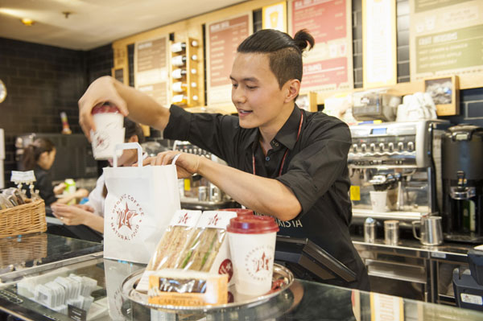
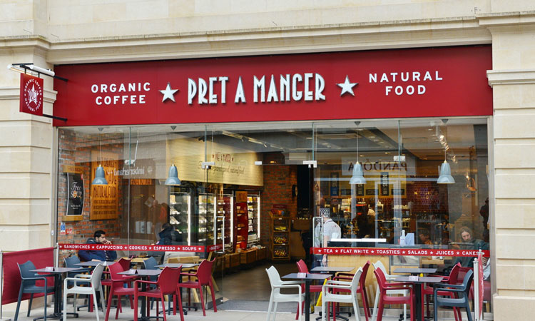
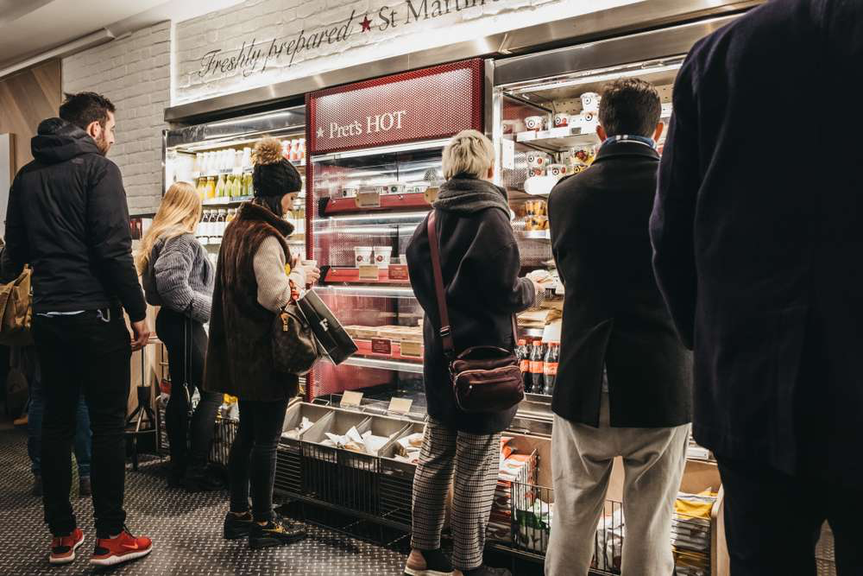
Observation Categories
Physical
Environment
Process
People

Slide 4
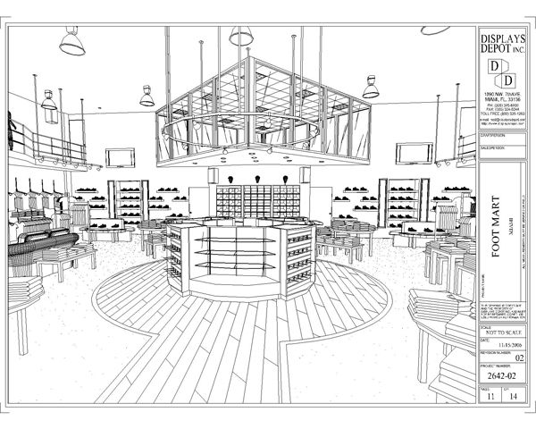


Research Process Design
With our main observation categories in mind, we settled in with our notebooks/pens and quietly just watched for a few hours to understand what type of data we could quantify/collect.
Chosen methods of information collection...
Take photographs of store and sketch the basic layout
Ask the staff certain questions
Note time taken to refill out of stock products
Act as clients and time service & queue
Remain in store for two time periods (late morning and lunchtime)

Slide 5
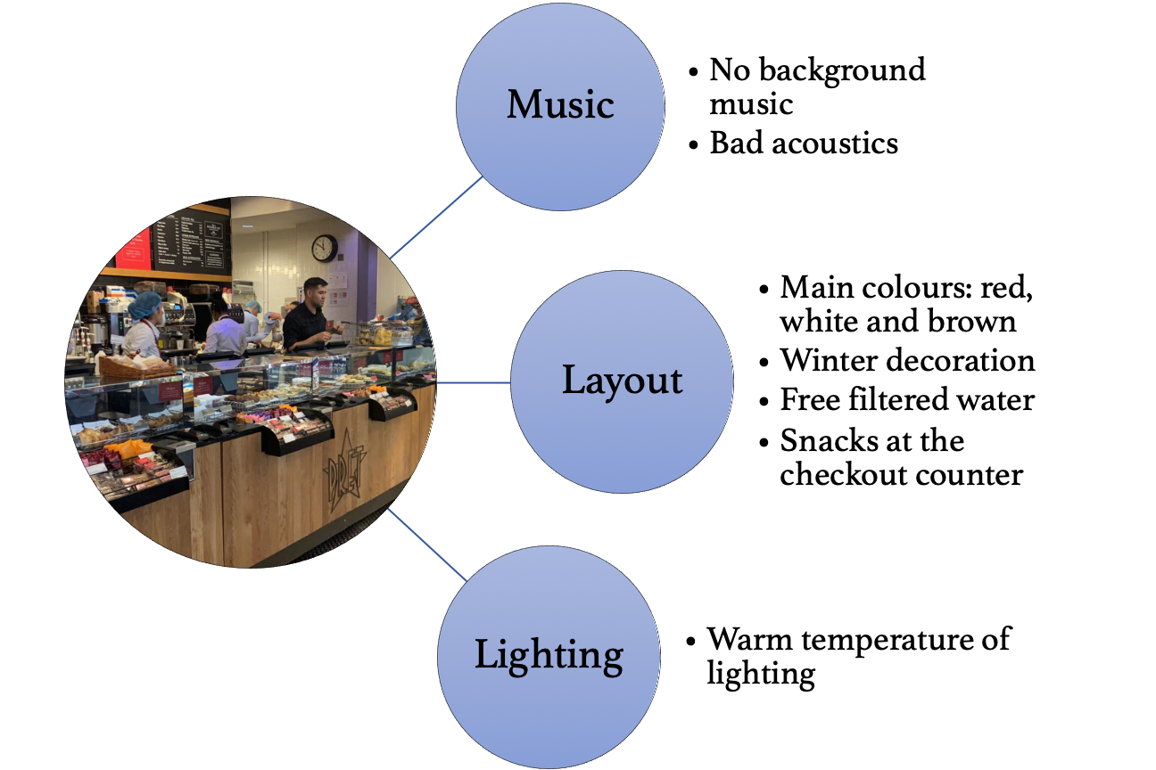
Our observations: Physical Environment

Slide 6
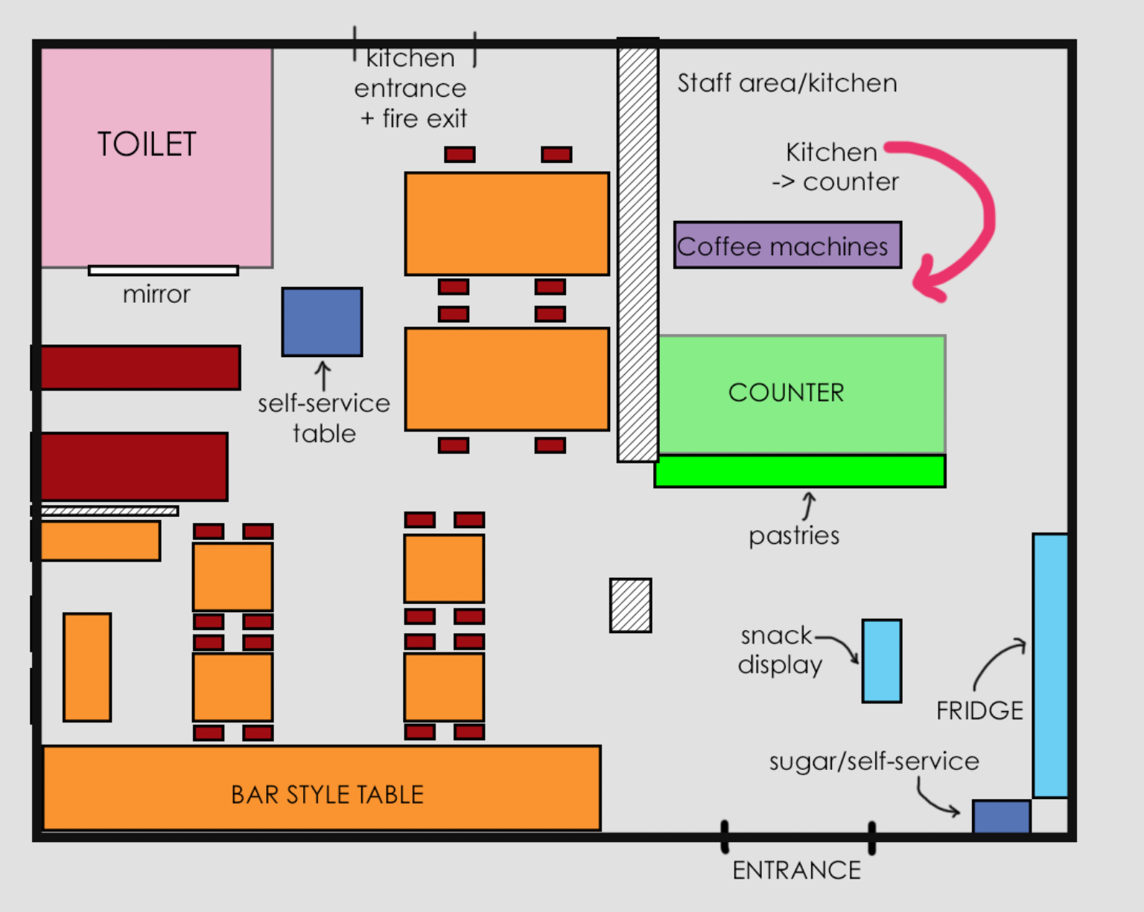
Basic Layout

Slide 7
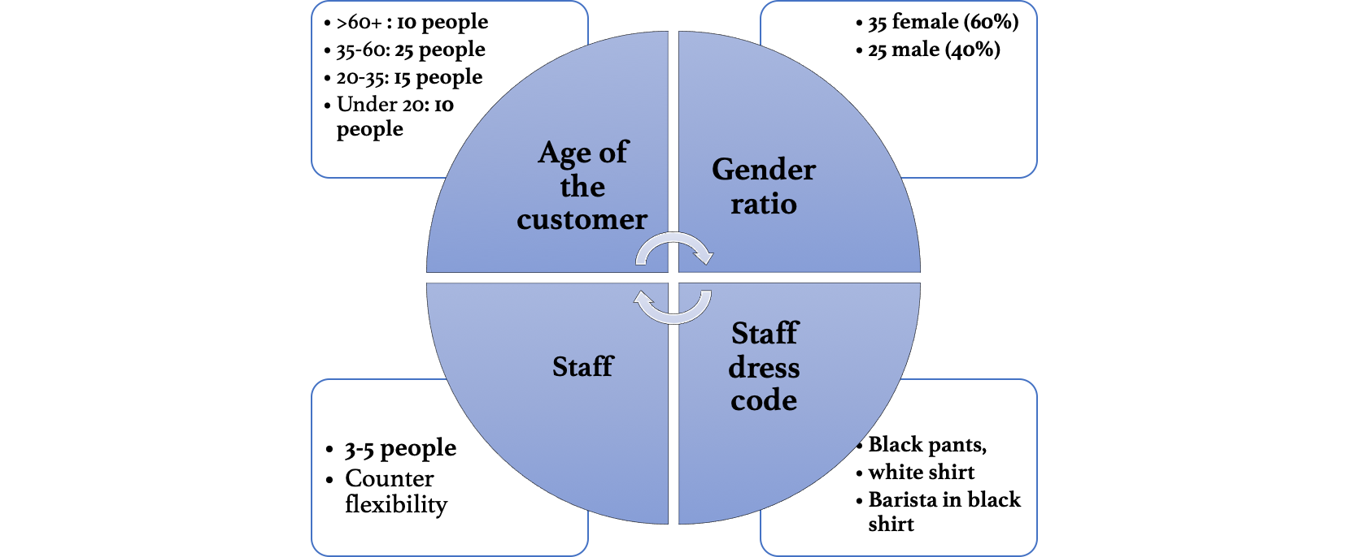
Our observations: People

Slide 8
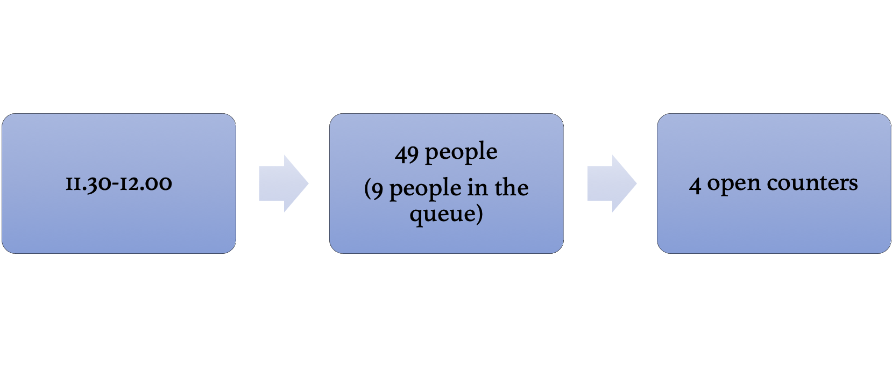
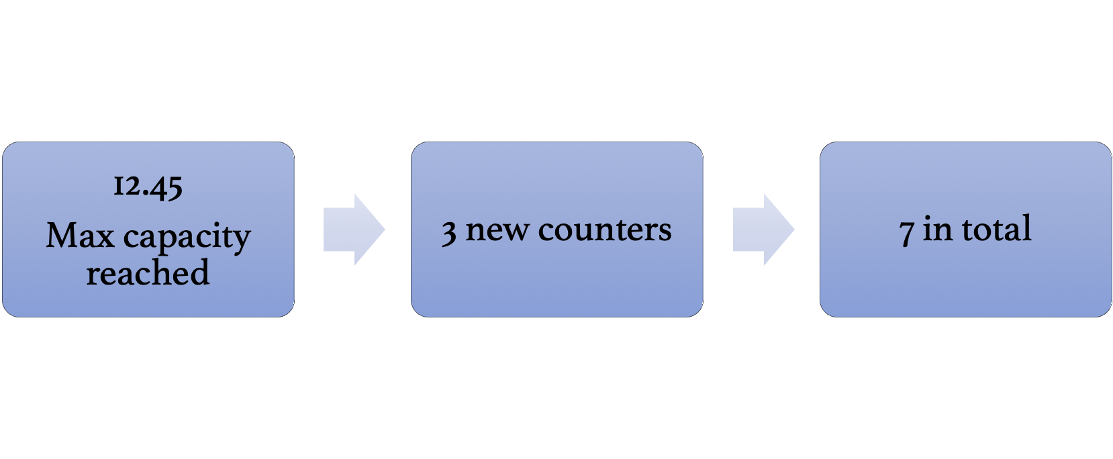
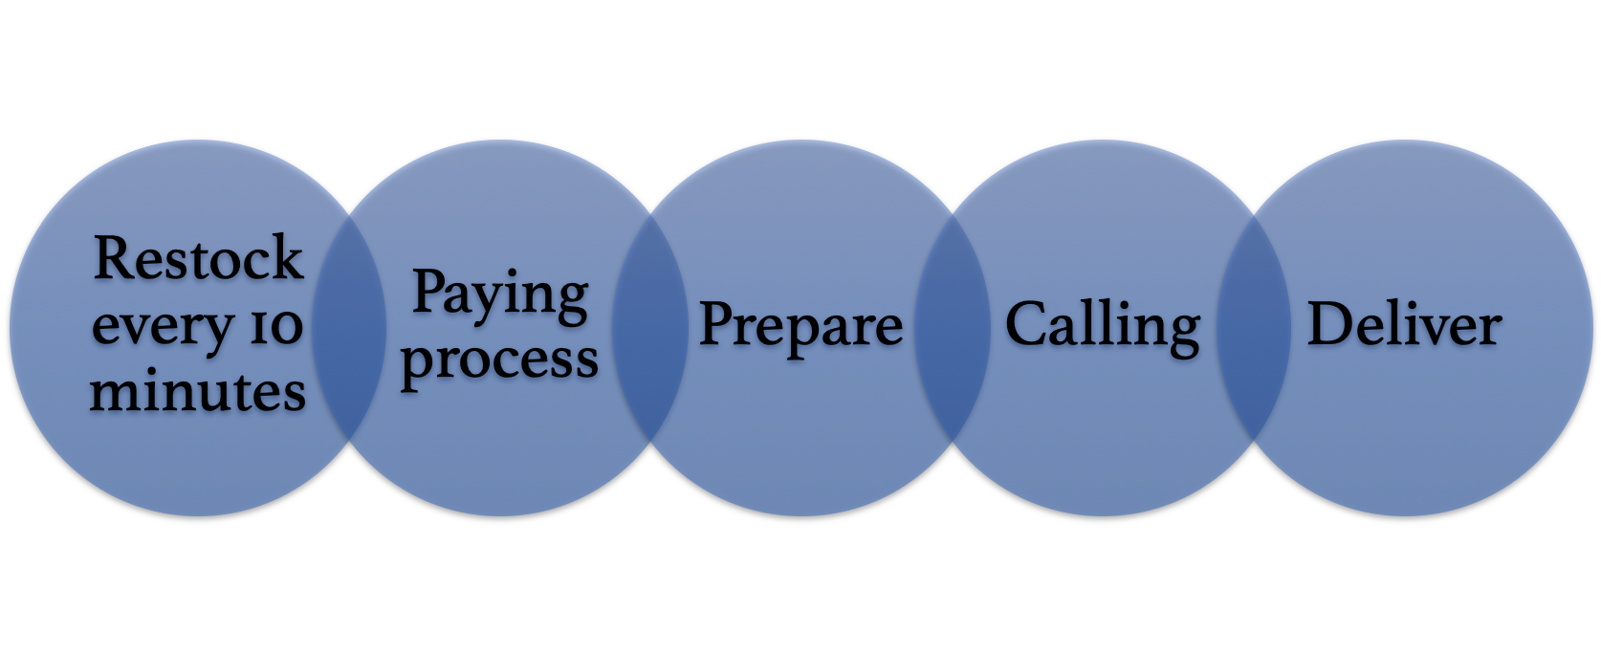
Our observations: Processes

Slide 9
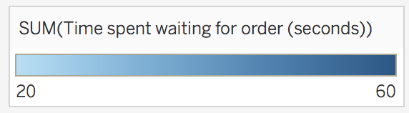
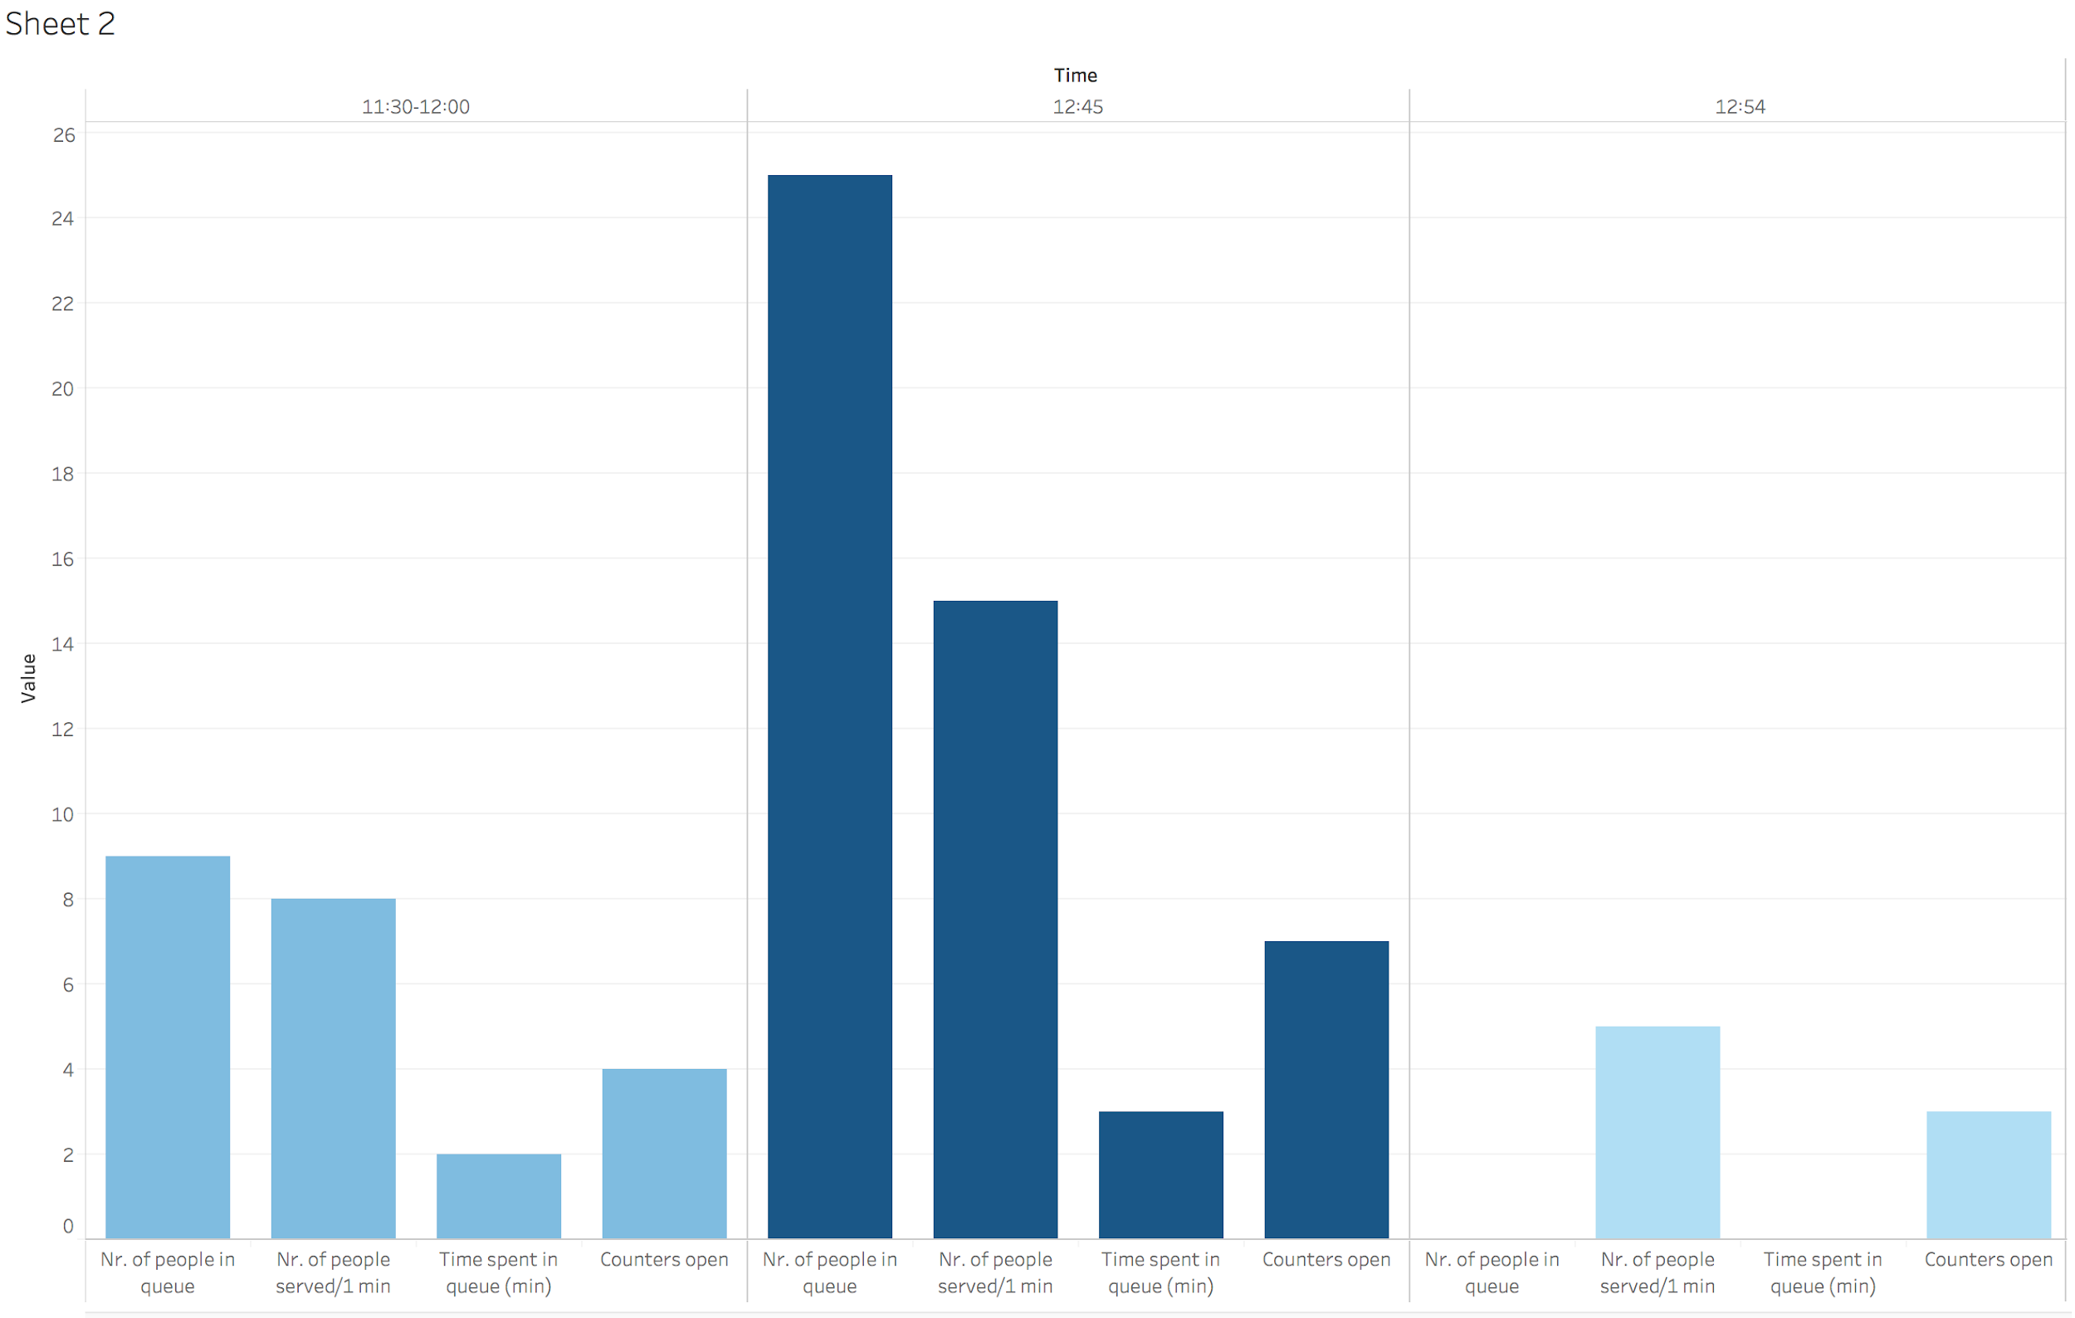
QUEUE

Slide 10
Pret vs. Caffe Nero
Physical Environment
No music
Colours: red & white
One large room
People
Higher demographic diversity: majority of customers are 35+ years old
Process & Performance
Counter flexibility allows for better demand management -> long queues are attended fast and don’t last long
Physical Environment
Relaxing music
Colours: black, white, blue, brown
Smaller rooms not connected to the queue with more space between tables
People
20-35 years old: majority of customers
Process & Performance
Even at peak time, only 1 of 3 counters is open -> very long queue
Payment after order is completed -> higher chance of getting a snack while waiting

